Slide 1
FACTORY METHOD
Triệu Quốc Huy
Lý Kim Long
Đinh Đạt Thành
Vũ Hoàng Quân

Slide 2
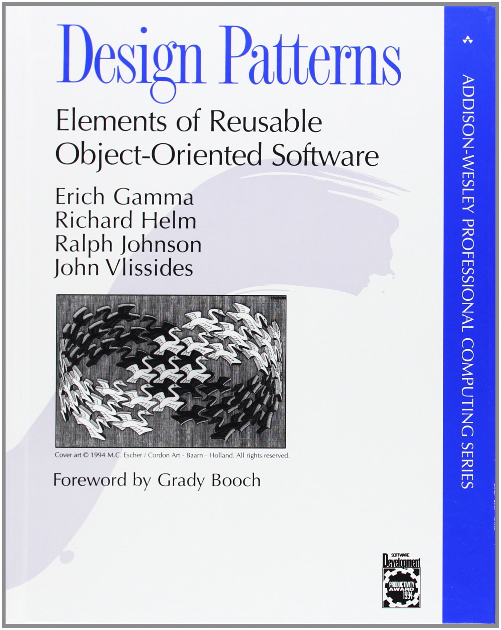
INTENT
"Define an interface for creating an object, but let subclasses decide which class to instantiate. The Factory method lets a class defer instantiation it uses to subclasses.“

Slide 3
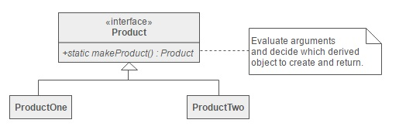
DEFINITION
A static method of a class that returns an object of that class’ type.
Defines and interface for creating the object and let subclasses decide which class to instantiate.

Slide 4
WHEN TO USE
A class can’t anticipate the class of objects it must create.
A class wants its subclasses to specify the objects it creates.

Slide 5
VARIATION
The Creator class is an abstract class and does NOT provide an implementation for the factory method it declares.
The Creator is a concrete class and provides a default implementation for the factory method.

Slide 6
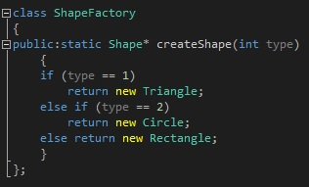
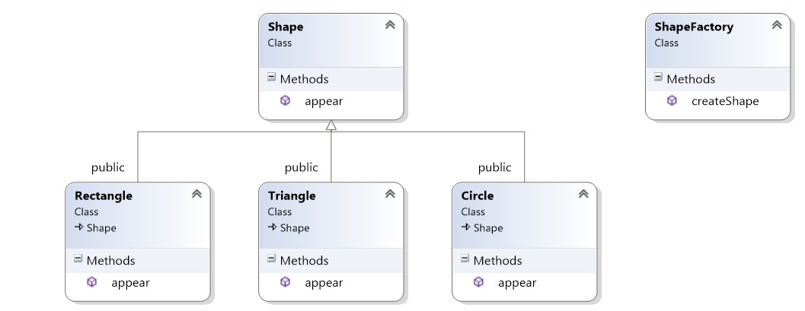
STRUCTURE

Slide 7
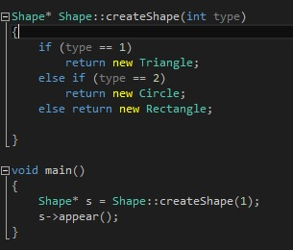
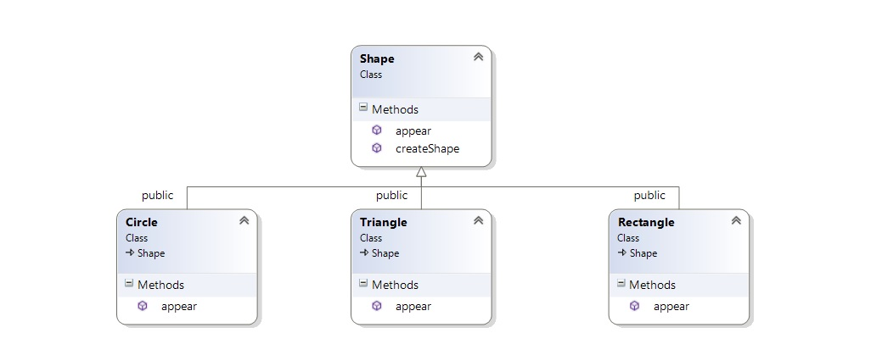

Slide 8
PROPERTY
Unlike a constructor, the actual object it returns might be an instance of a subclass.
Unlike a constructor, an existing object might be reused, instead of a new object created.
Unlike a constructor, factory methods can have different and more descriptive names, for example :
Color.make_RGB_color(float red, float green, float blue)
Color.make_HSB_color(float hue, float saturation, float brightness)

Slide 9
COMPARISION
FACTORY METHOD | ABSTRACT FACTORY
A method which can be overridden by subclasses. Creates object through interfaces. Contains method to produce the products of its type. | An object which contains multiple factory method. Creates object through composition. Contains family of types and method to produce.

Slide 10
ADVANTAGES
Factory Method makes a design more customizable and only a little more complicated. Other design patterns require new classes, whereas Factory Method only requires a new operation.
It can return the same instance multiple times, or can return a subclass rather than an object of that exact type.

Slide 11
DISADVANTAGES
Additional code, difficulty in understand the general flow and a confusing inducing class diagram.

Slide 12
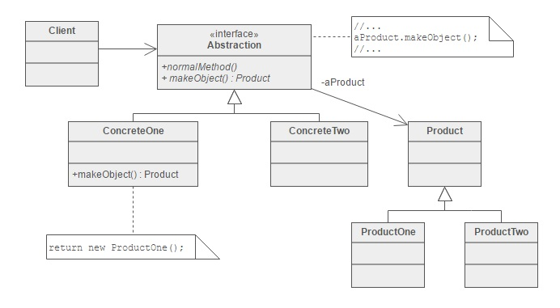
APPLICATION
Factory Methods are routinely specified by an architectural framework, and then implemented by the user of the framework.
People often use Factory Method as the standard way to create objects

Slide 13
THE END
Thanks for listening!

